Slide 1
Lending Club – Case Study
Lending Club – an online agency which hosts a marketplace to mediate between investors and borrowers wants to analyse their data to minimise the risk of losing money while lending to customers.
The available subset of data is between 2007 and 2011 (5 years) to identify driving factors for a profitable business model.
James Jeyabalan / Akik Ranade

Slide 2
As per the provided dataset, after going through the data analysis, the following slides display some of the business findings which could be of interest to both Lending Club as well as the Investor as far as the selection of Loan Applicants is concerned.
Business Findings

Slide 3
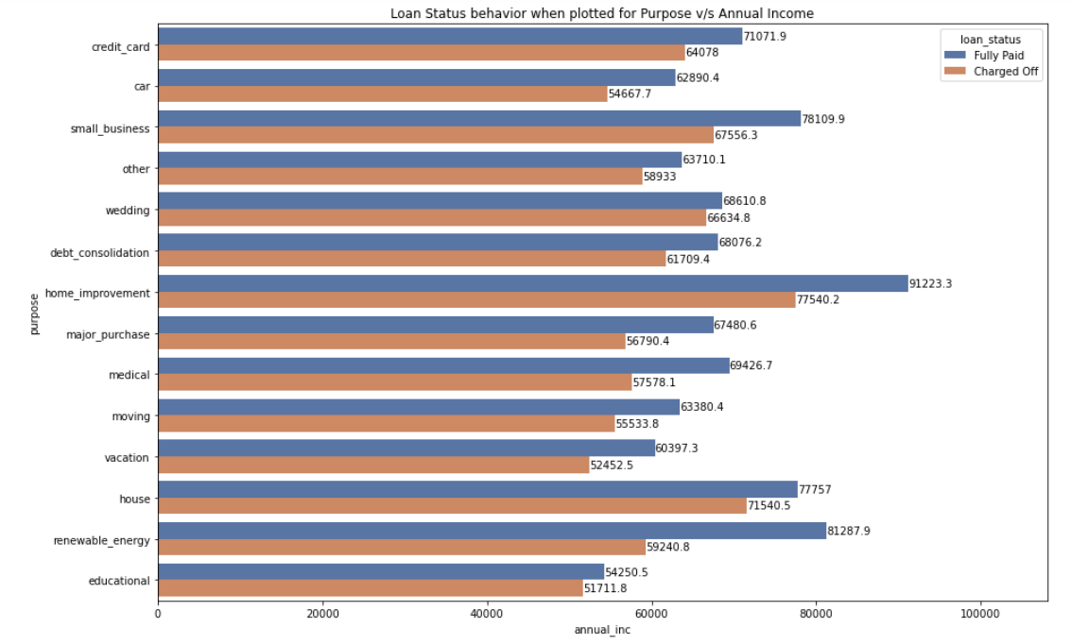
In the performed analysis, there is more probability of defaulting when : Applicants taking loan for ‘Home Improvement' and have income of 75K-80K.

Slide 4
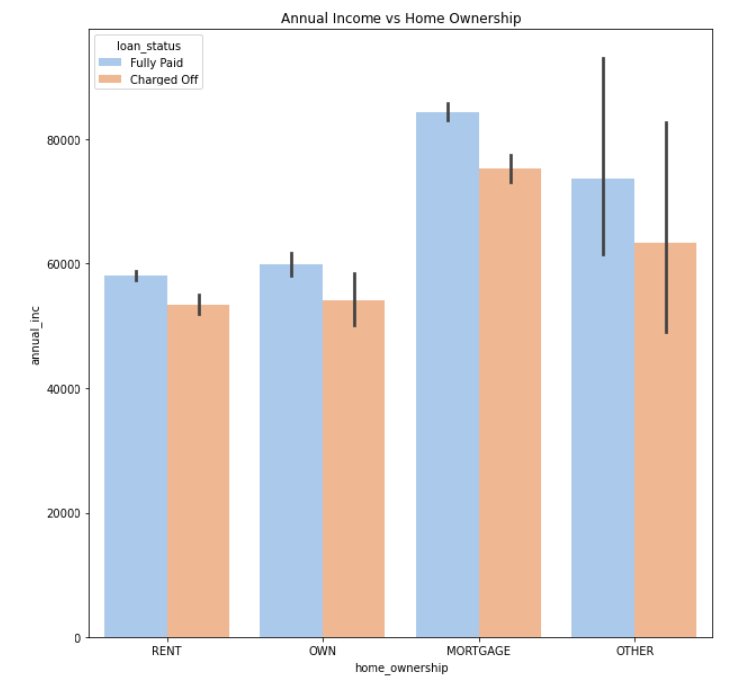
In the performed analysis, there is more probability of defaulting when : Applicants whose home ownership is 'MORTGAGE and have income of 70K-80K.

Slide 5
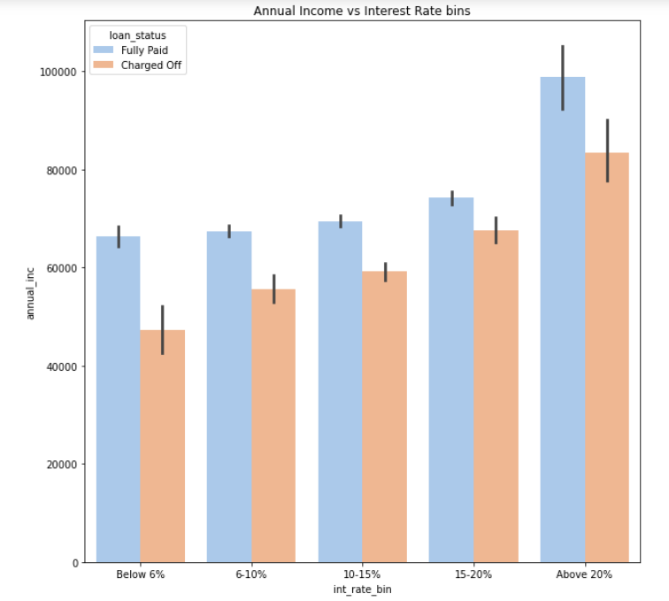
In the performed analysis, there is more probability of defaulting when : Applicants, with an annual income of 70K-80K, who are charged an interest rate of 20% & above.

Slide 6
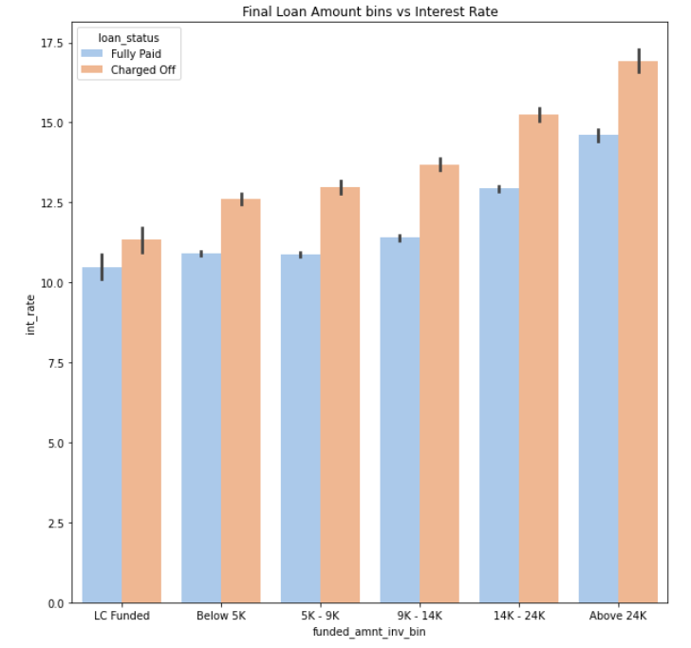
In the performed analysis, there is more probability of defaulting when : Applicants, whose loan amount is above 24K, with charged interest rate of 15%-17.5%.

Slide 7
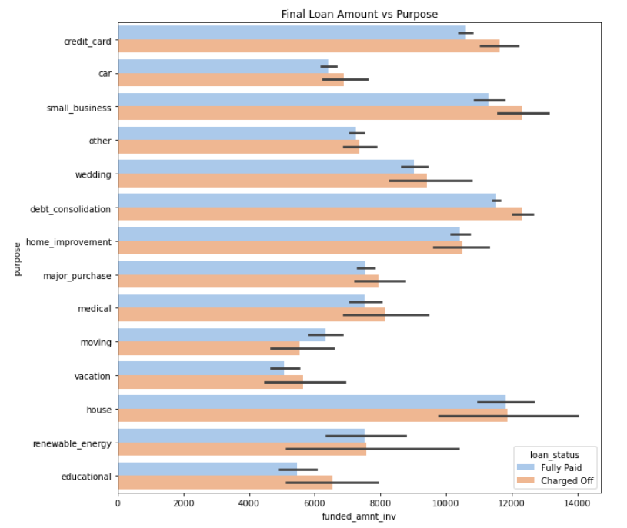
In the performed analysis, there is more probability of defaulting when : Applicants, who have taken a loan for small business & debt consolidation, where the loan amount is greater than 12K.

Slide 8
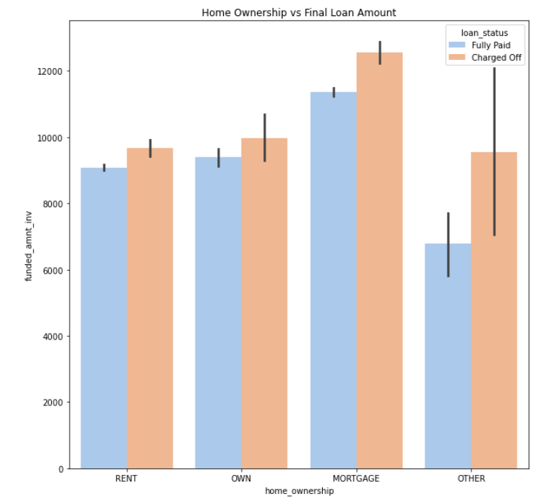
In the performed analysis, there is more probability of defaulting when : Applicants whose home ownership is 'MORTGAGE’ & whose final loan amount is above 12K.

Slide 9
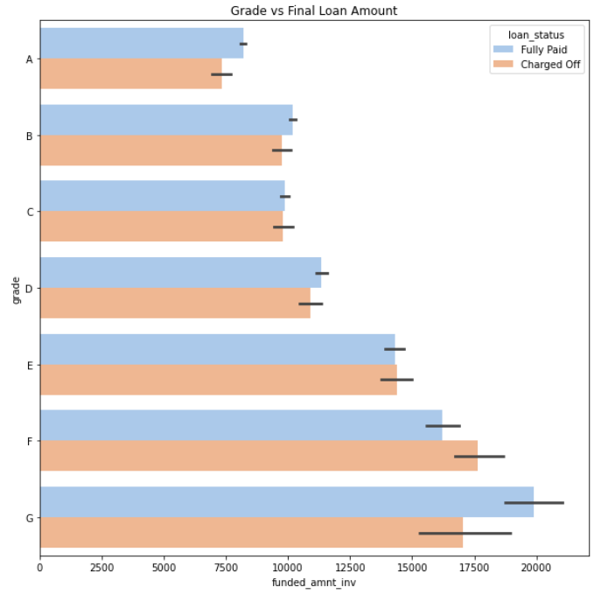
In the performed analysis, there is more probability of defaulting when : Applicants with lower grades (F & G) with loan amount more than 15K.

Slide 10
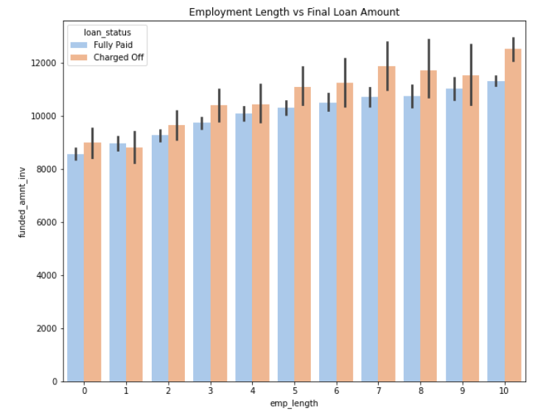
In the performed analysis, there is more probability of defaulting when : Applicants whose employment length is 10 years, and their loan amount is above 12K.

Slide 11
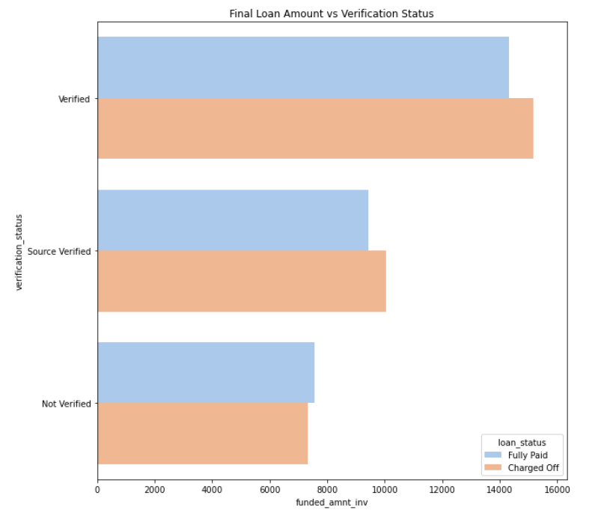
In the performed analysis, there is more probability of defaulting when : Applicants whose loan is verified with the loan amount above 14K.

Slide 12
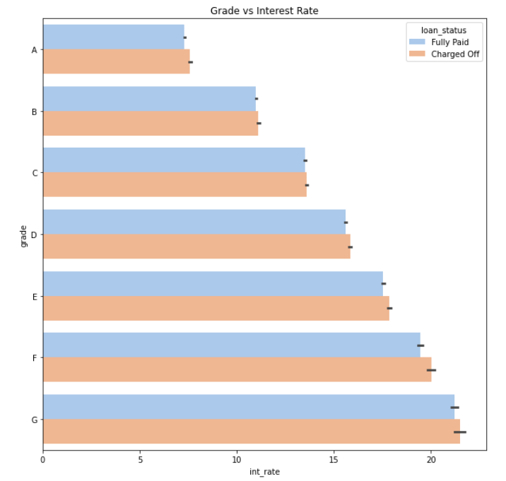
In the performed analysis, there is more probability of defaulting when : Applicants have lowest grade (G) and must pay interest at a rate above 20%.

Slide 13
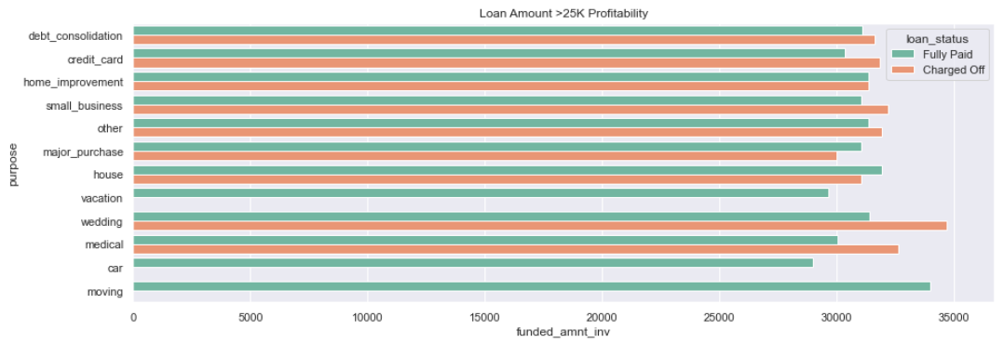
Additional Findings: Wedding and Medical loans have higher default rate Vacation, Car and Moving loans have No defaulters * Considering only the loan amounts above 25K USD

Slide 14
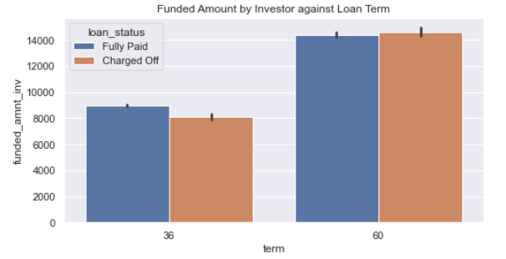
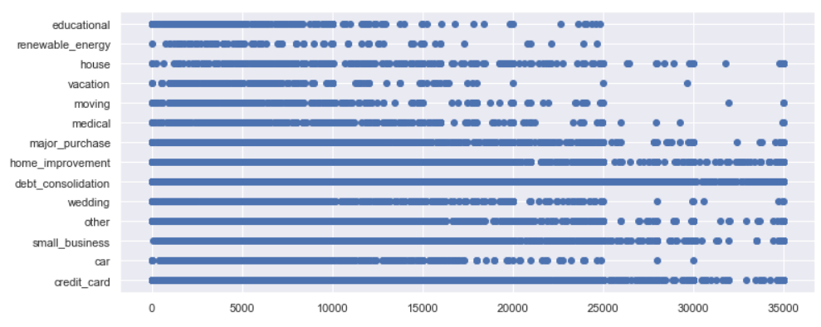
Additional Observation
Longer the term, higher the loan amount taken
a
A large portion of high loan amounts are for Debt Consolidation, Credit Card & Home Improvement
3/4th of the loans taken are for the above 3 categories

Slide 15
Recommendations for the Lender:
It is a sign of potential risk when lending for applicants who are applying for a loan when their house ownership status corresponds to an ongoing Mortgage. Based on the above analysis, it would be safe to assume that such applicants be either denied a loan or given a lower loan approval based on their annual income and other relatable criterion.
a
It can be observed in the analysis that lower the grade, the higher is the default probability. Therefore, it can be recommended that higher graded loan applicants be preferred when approving for loans.
There is an observation that as the employment length of an applicant increases, the applicant is more likely to default. Therefore, lower employment length applicants could be given preference over applicants with higher employment experience.
Applicants whose purpose of seeking a loan is Wedding have been probable to default more often as per the analysis and therefore could be red-flagged or possibly avoided to avert financial losses for the lender.
With regards to Interest rates being applicable to customers with loan amounts above 24K, there is a high rate of default. Hence, such applicants could be considered with lower interest rates if deemed worthy based on further extensive analysis of their financial background.

Slide 16
Thank you

